Slide 1

PORTFOLIO-
VISHWAKARMA MANISHKUMAR DURBHASH
(19BCE10303)

Slide 2

Hi !
Welcome to my porfolio
PAGE 01

Slide 3
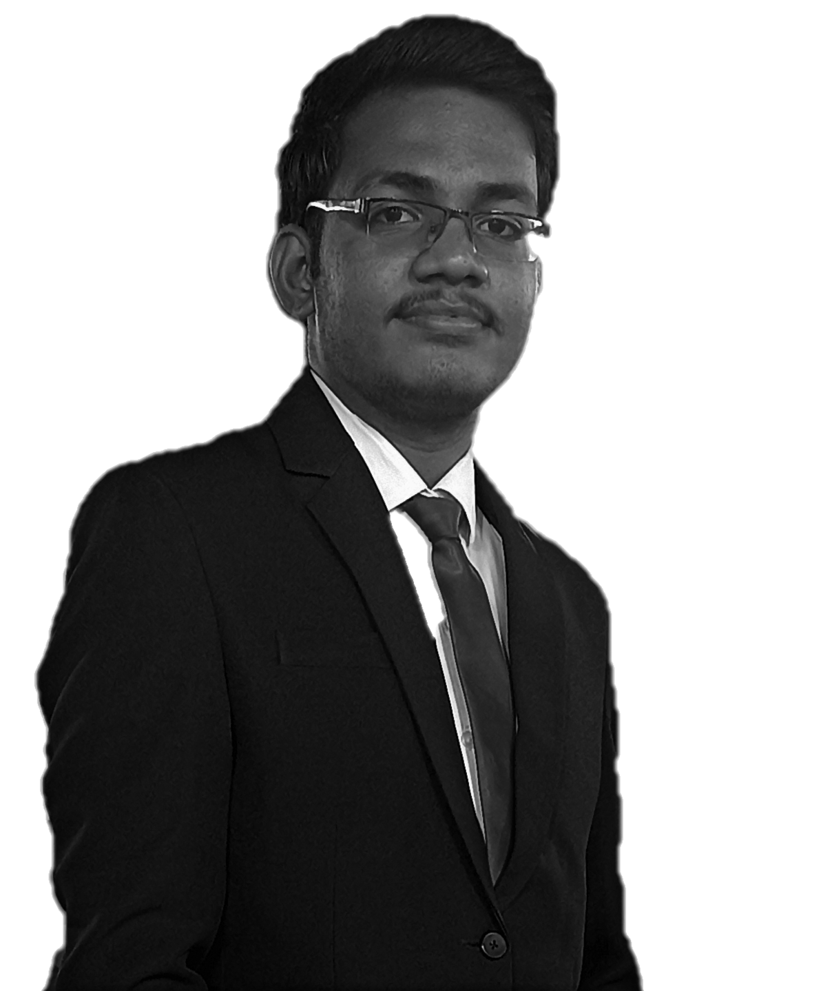
INDRODUCTION:
I am now SDE Intern at Fareportal.
I have also prior experience of Android and Full Stack Web development
I'm interested to learn new technology in IT demand & I am lot of curious about to learn Backend technologies as well as Front end
Technologies.
PAGE 02
PAGE 03

Slide 4

TABLE OF CONTENTS
About me
Education
Experience
Projects
Skills
Interests/ Hobbies
Contacts
PAGE 04
PAGE 05

Slide 5
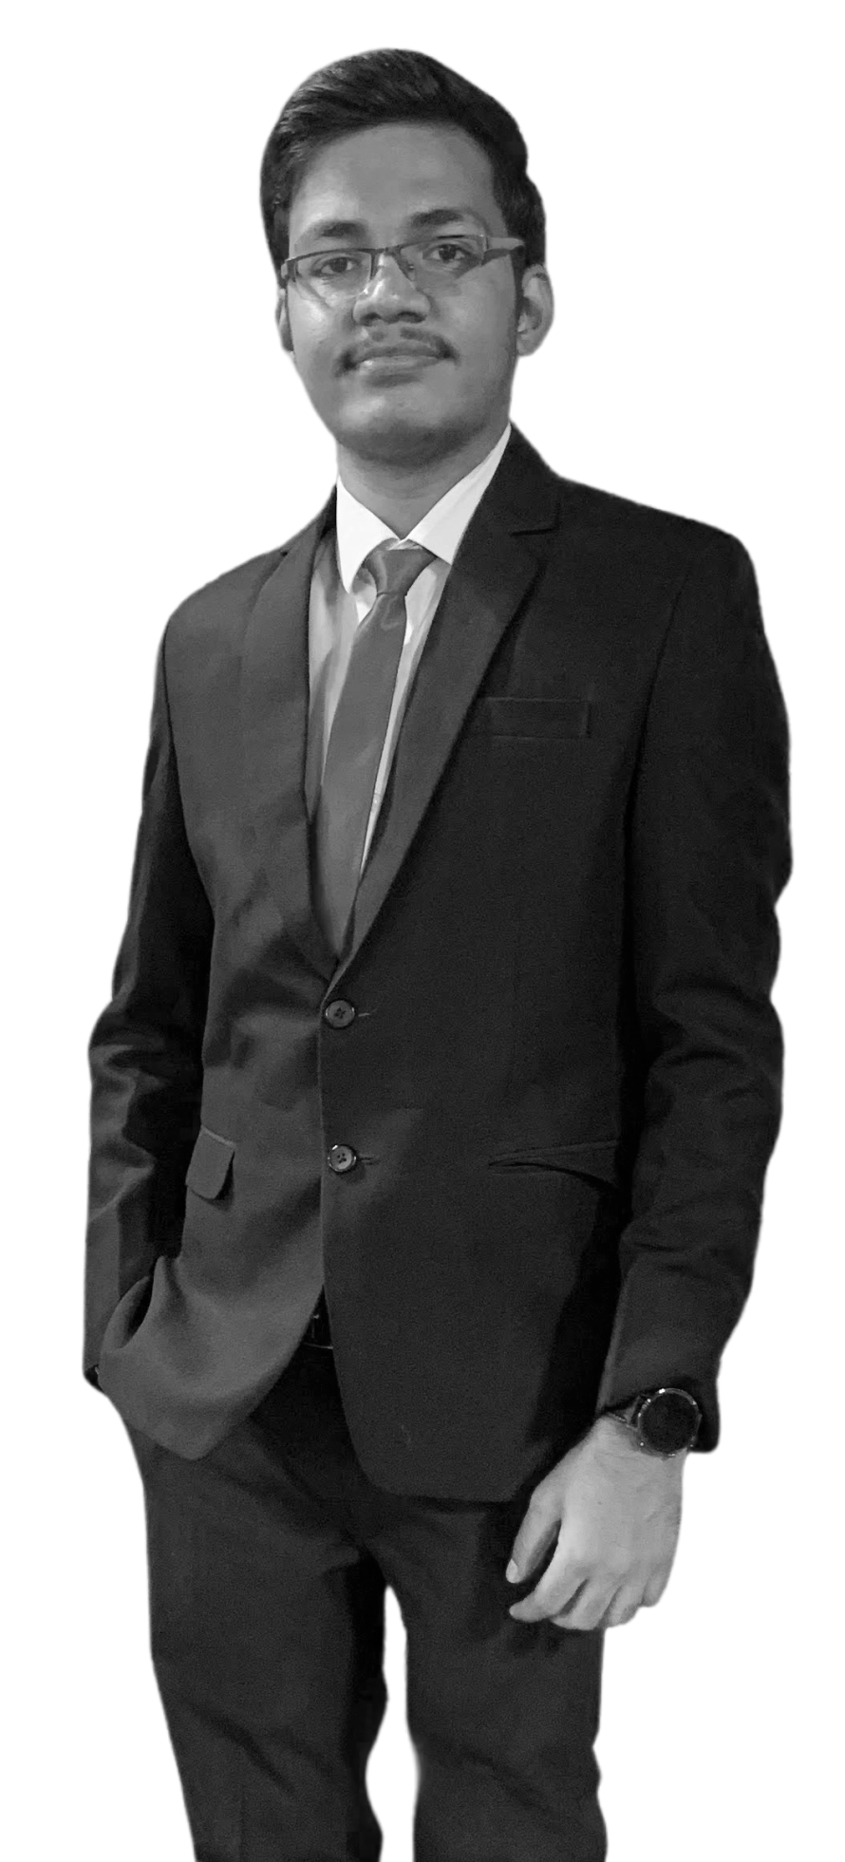
ABOUT ME
My name is Manishkumar Vishwakarma. I'm a Full Stack developer cum Software engineer from Mumbai, Maharashtra, India.
PAGE 06
PAGE 07

Slide 6
ABOUT ME
I am a professional and passionate programmer in my daily life. A quick learner with a self-learning attitude. I love to learn and explore new technologies and am Passionate about Problem Solving. Love almost all the stacks of Software Engineering. My current stack includes Asp.net, ReactJs, NextJs, Redux, Bootstrap, Material UI, MongoDB, Mysql, PostgreSQL, Firebase,etc.
PAGE 08
PAGE 09

Slide 7




EDUCATION
BACHELOR’S DEGREE OF TECHNOLOGY in the FIELD OF COMPUTER SCIENCE ENGINEERING FROM VIT, BHOPAL UNIVERSITY,
(2019-2023), CGPA: 9.25 until
HSC (PCMB) FROM SVKM’S MITHIBAI COLLEGE
MUMBAI, MAHARASHTRA,
(2016-2018), Agg: 85.38%
SSC From Mumbai university, Maharashtra
(2015-2016), Agg: 90.20%
PAGE 10
PAGE 11

Slide 8



EXPERIENCE
SOFTWARE ENGINEER INTERN,
FAREPORTAL
(Oct 2022 - current)
DATA SCIENCE INTERN
SMART INTERNZ
(May 2021 – Jun,2021)
ANDROID DEVELOPER INTERN
BLUE PLANET INFO SOLUTIONS
(2015-2016)
PAGE 08
PAGE 09

Slide 9
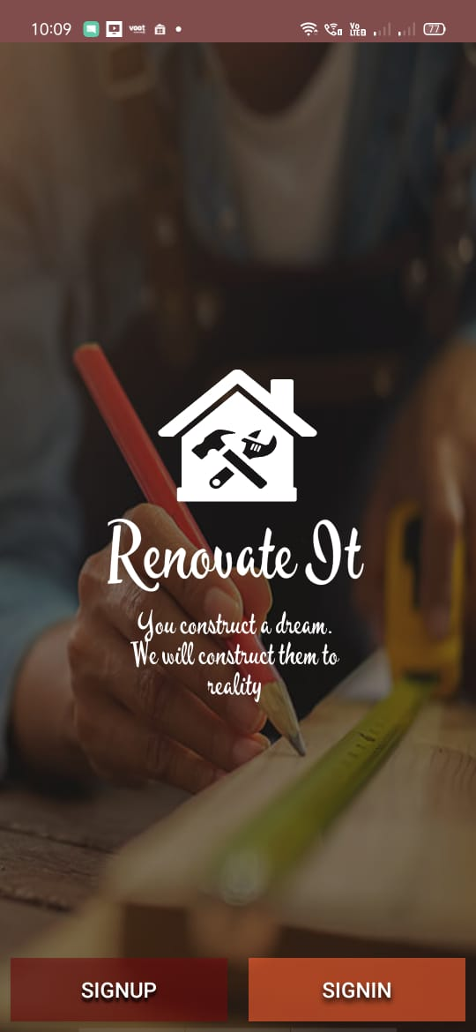
PROJECTS :
Renovate It
Description: Designed and developed a real-time home service android application specifically targeted for the daily workers, laborers to get in touch with the contractors. -Technology: Android, Firebase database, Firebase messenger, SQLite, JAVA, etc.
Team Project: 3 members
Role: Android Developer -Link: https://github.com/manishdpv/RenovateIt.git
PAGE 10
PAGE 11

Slide 10
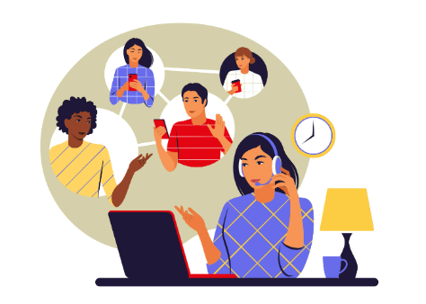
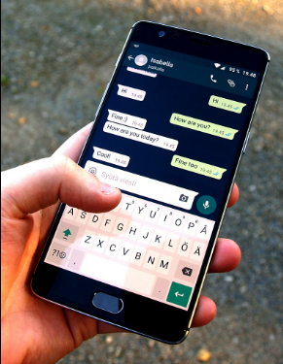
PROJECTS :
CLAN (A Desktop chat application on Local Area Network)
Description: Designed and developed a real-time desktop chat application using socket programming in JAVA language. It includes the features such as send messages, share images, files, live video stream, chat history. Technology: Core Java, Java Networking. Link:https://drive.google.com/drive/folders/1e_jzr6bKTN_cPRruTPHNx4agmKYe1Qyn?usp=sharing
PAGE 10
PAGE 11

Slide 11





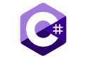




SKILLS:
Programming Languages: C, C++, C#, JAVA, Pyhon.
Technology stack: Android Development, Web development.
Framework: ReactJs, Asp.net, Bootstrap
Databases: Firebase, MySQL, Mongodb
Others: Git, Nodejs, MaterialUI
PAGE 12
PAGE 13

Slide 12


HOBBIES:
Watching Standups comedy
Sketching
Browsing
PAGE 12
PAGE 13

Slide 13
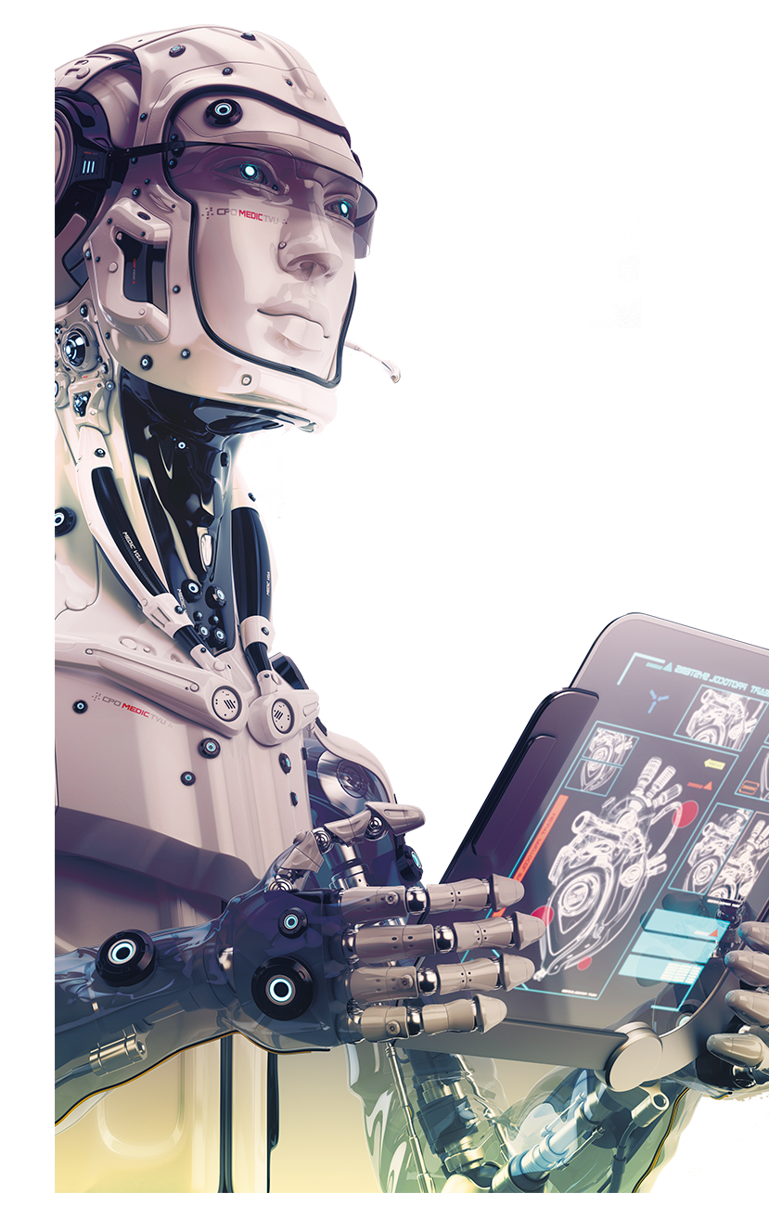
CONTACTS:
My portfolio Website:
https://manishvishwakarma.netlify.app/about
PAGE 14
PAGE 15

Slide 14
THANK
YOU
PAGE 16

Slide 15
THANK YOU

